Slide 1
CAPSTONE PROJECT
PROJECT REPORT ON:
Plant Disease detection using image processing and machine learning
SUBMITTED BY:
SUBMITTED TO:
17BEI0077 - SHREY GUPTA
17BEE0288 – ISHAN GOEL
17BEE0358- RAHUL GUPTA
Dr. RAJINI GK
Associate Professor
School of Electrical Engineering

Slide 2
Abstract:
Agriculture sector is the backbone of Indian economy as well as vital for human survival, therefore it is necessary that the farmers are provided with advance technologies and farming equipment‟s, so that the quality of crops does not get compromised. In this project a methodology is proposed which can help in detection of plant disease if any in its early stages itself .Therefore helping the farmer to take the appropriate action in order to avoid damage toall the crops .This methodology is based on the Image processing and Machine learning
techniques which are used to segment the leaf images and classifying the images in two classes i.e. diseased or healthy respectively.

Slide 3
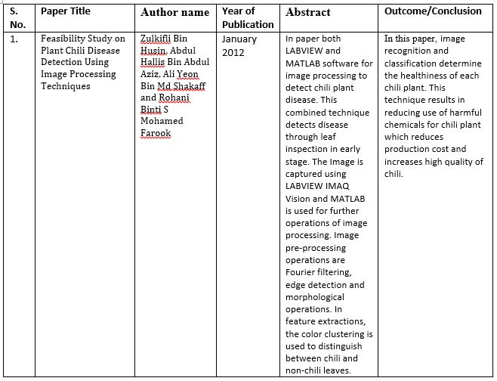
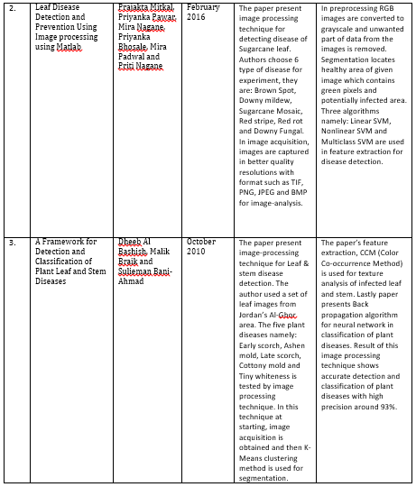
Literature Review:

Slide 4
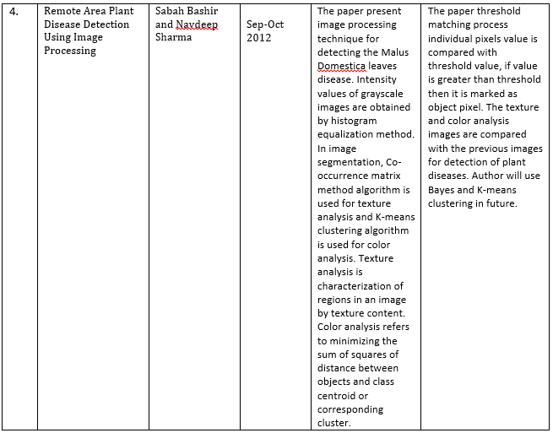
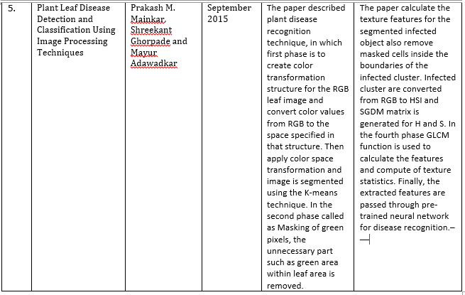

Slide 5
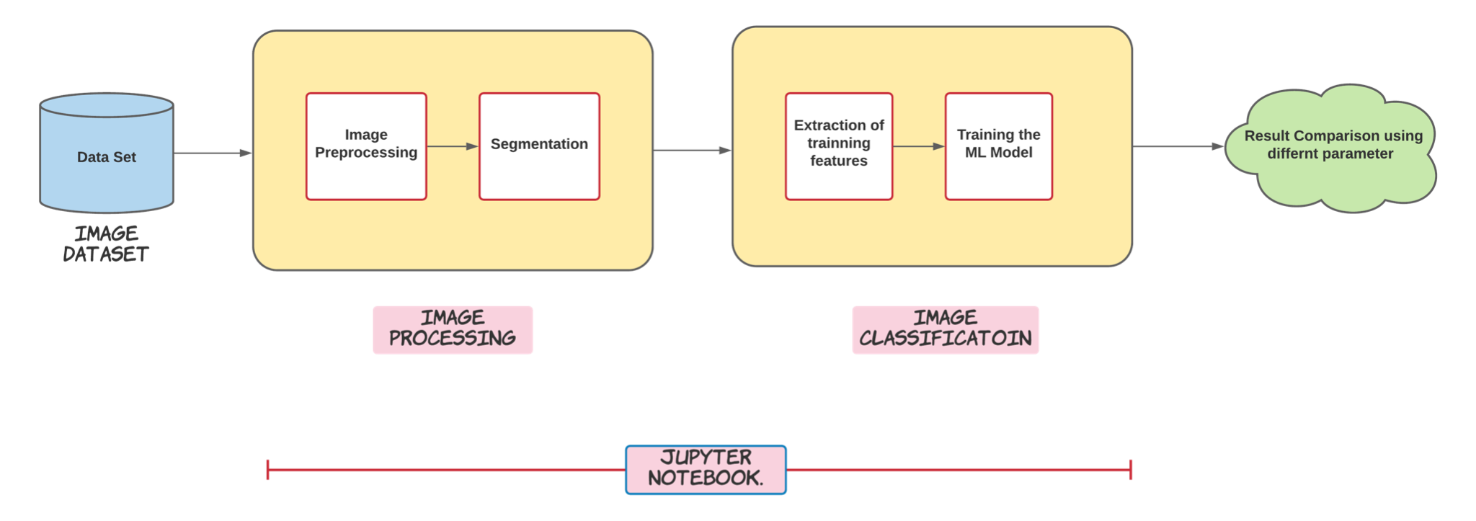
Block Diagram:
System Architecture

Slide 6
Methodology:
The step-by-step procedure of the proposed system:
Image Acquisition
Pre-Processing the Image
Segmentation of the Image
Extraction of Feature
Trainning the classifier.

Slide 7
Image Acquisition
The image dataset was taken from github.
The data set contains of 1711 images of leaf where 905 are healthy image and 806 are diseased image.
The images are in JPEG format
https://github.com/spMohanty/PlantVillage-Dataset/tree/master/raw/color

Slide 8
Image pre-processing
The data is in form of images thus there's need to do some pre-processing before running the segmentation algorithm.
The image is converted to RGB color space from BGR (Blue Green Red) color space. Then it is converted to HSV color space from RGB color space.
The image is converted to HSV color space as it results in more precise representation of extracted features of interest in the image.
The images are resized into 500pixels*500pixels.

Slide 9
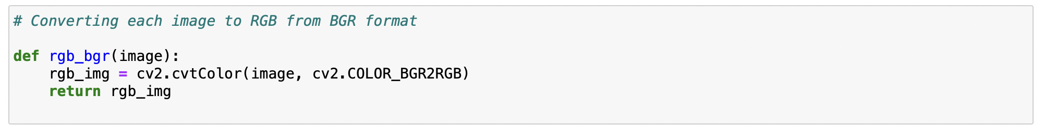
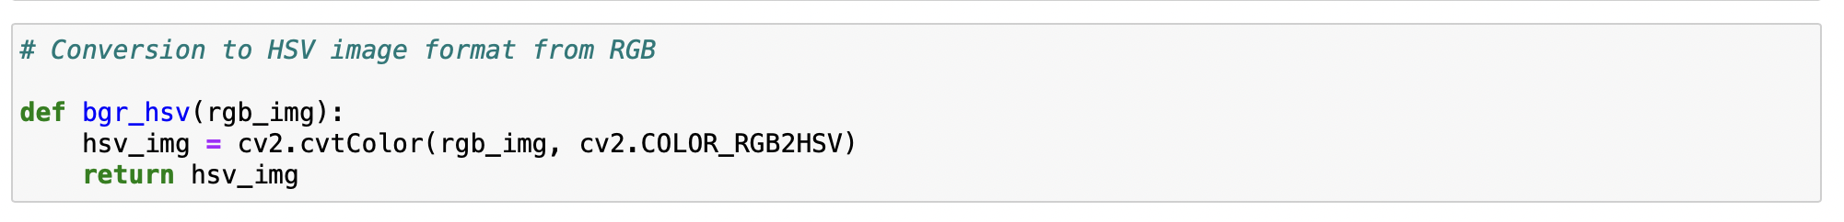
Implementation:

Slide 10
Segmentation of Image
Image segmentation is implemented to divide a digital image into numerous segments.
The objective of the segmentation is to streamline and additionally change the portrayal of a picture which is more significant and simpler to investigate.
We are using 2 segmentation algorithm
1) Green Masking Technique
2) SLIC Segmentation

Slide 11
Green Masking Technique
This is a threshold based segmentation technique.
A range of pixel values are chosen which are called as mask.
Each pixel is compared in the image with the chosen mask. IF the value of pixel is not in range it is set to 0 i.e. turned black. ELSE the value is not changed.

Slide 12
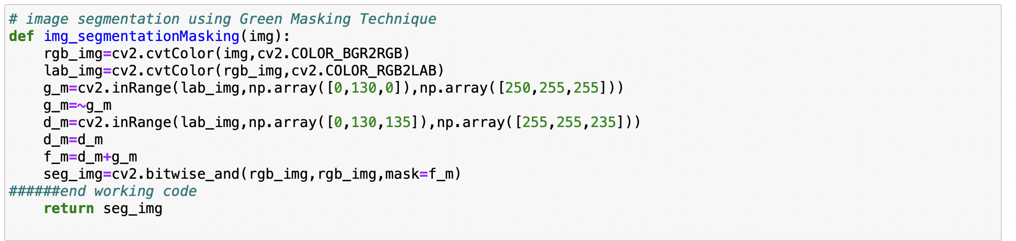
Implementation

Slide 13
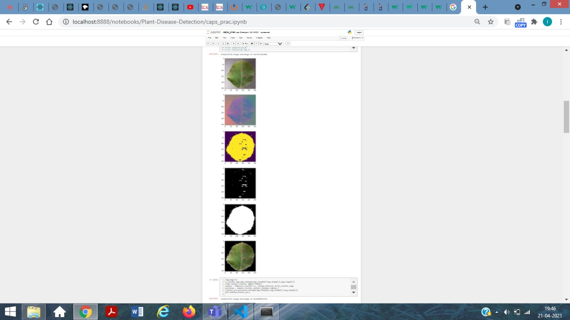
OutPut:

Slide 14
SLIC Segmetation
SLIC is a type of clustering based segmentation algorithm.
This algorithm creates the super-pixel by dividing image of n pixels into k clusters of equal size as the input parameter.
Then the center of these clusters are adjusted according to the distance metric over different iterations.
Finally an image is obtained on dividing into k clusters after iterations are over

Slide 15
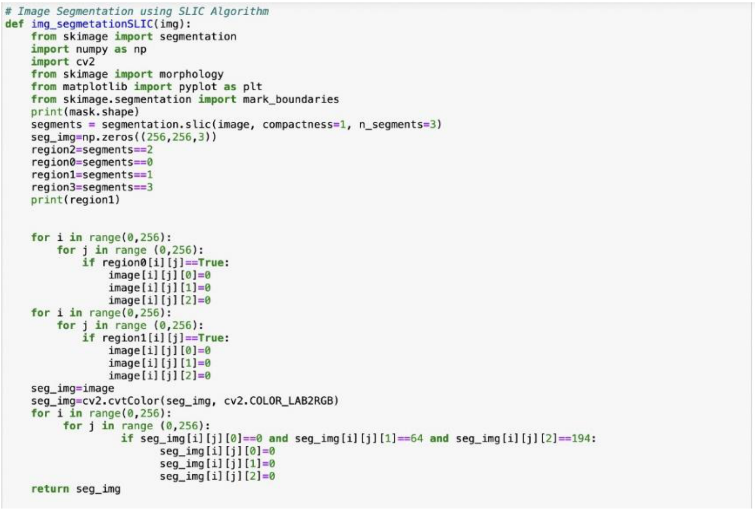
Implementation

Slide 16
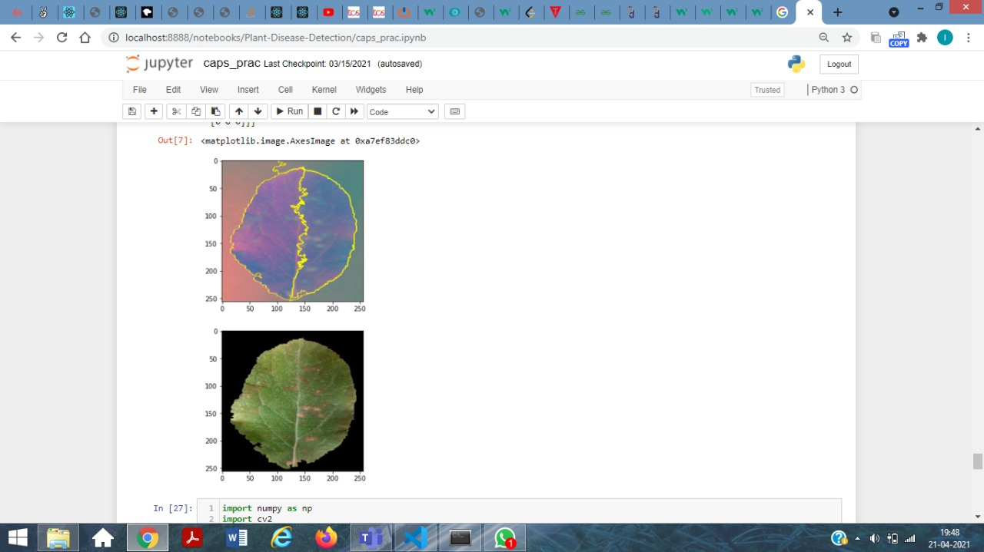
Output

Slide 17
Extracting Features:
Using the segmented images we extracted a total of 550 features.
We extracted
1) Hu Moments
2) Haralic Features
3) Color histogram
4) Color features using color co-occurrence matrix

Slide 18
Hu Moments:
In PC vision and image processing, picture moments are regularly used to portray the state of an item in a picture.
These moments catch fundamental data like the space of the article, the centroid (for example the middle (x, y)- directions of the item), the direction, and other attractive properties.
Hu proposed 7 moments that can be utilized to describe the state of an article in a picture.

Slide 19
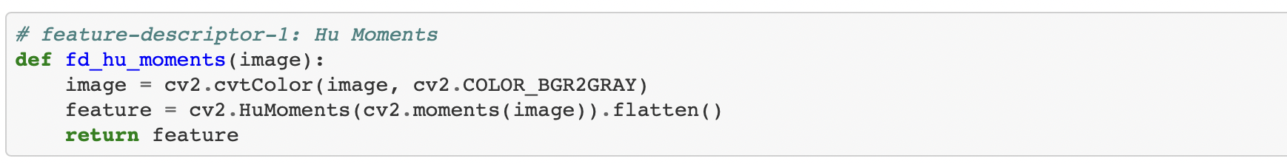
Implementation

Slide 20
Haralic Features
Texture is a description of spatial arrangement of colors or intensities of an image.
Haralick texture feature is statistical based which is calculated from a Gray Level Co-occurrence Matrix, (GLCM), a matrix that counts the co-occurrence of neighboring gray levels in the image.
The GLCM is a square matrix that has the element of the quantity of dim levels N in the district of interest (ROI).

Slide 21
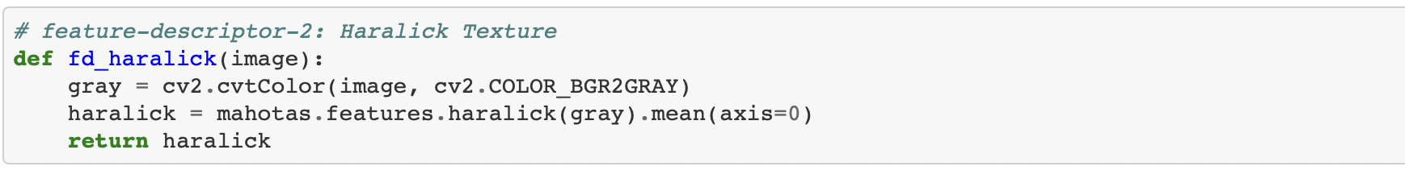
Implementation

Slide 22
Color Histogram:
Color Histogram is the most advanced tool for separating the shading highlight of a picture.
It addresses the picture from an alternate point of view. It addresses the recurrence dispersion of shading containers in a picture.
It checks similar pixels and stores them.

Slide 23
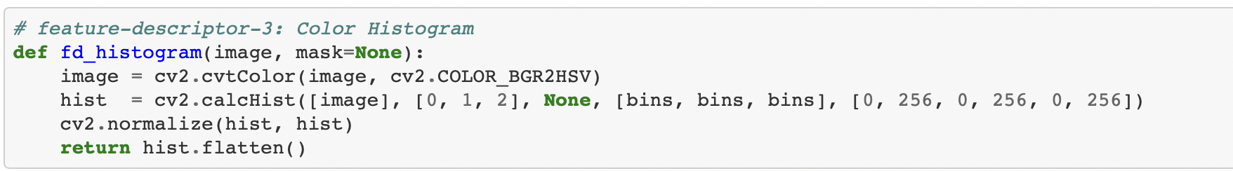
Implementaion:

Slide 24
Color features using color co-occurrence matrix
The color co-occurrence matrix is another method to find out color features of an image.
• Some of the features extracted are: Hue Energy, Saturation (HSL) entropy, Saturation (HSV) entropy, a(L*a*b) entropy, Saturation (HSL) IDM, Value IDM, Red SumMean, Green SumMean, Grey SumMean, Light SumMean etc

Slide 25
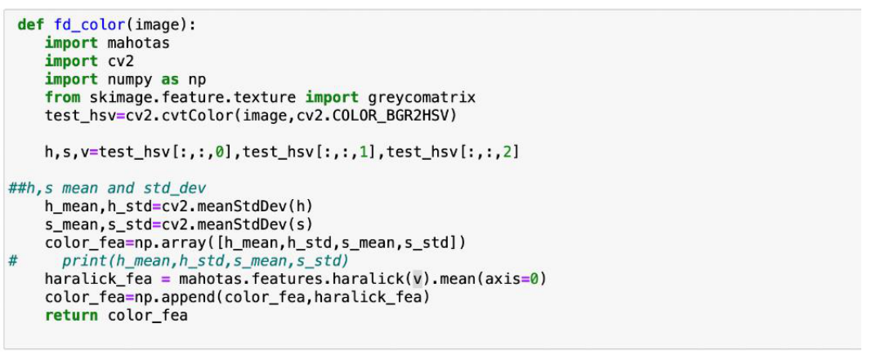
Implementation

Slide 26
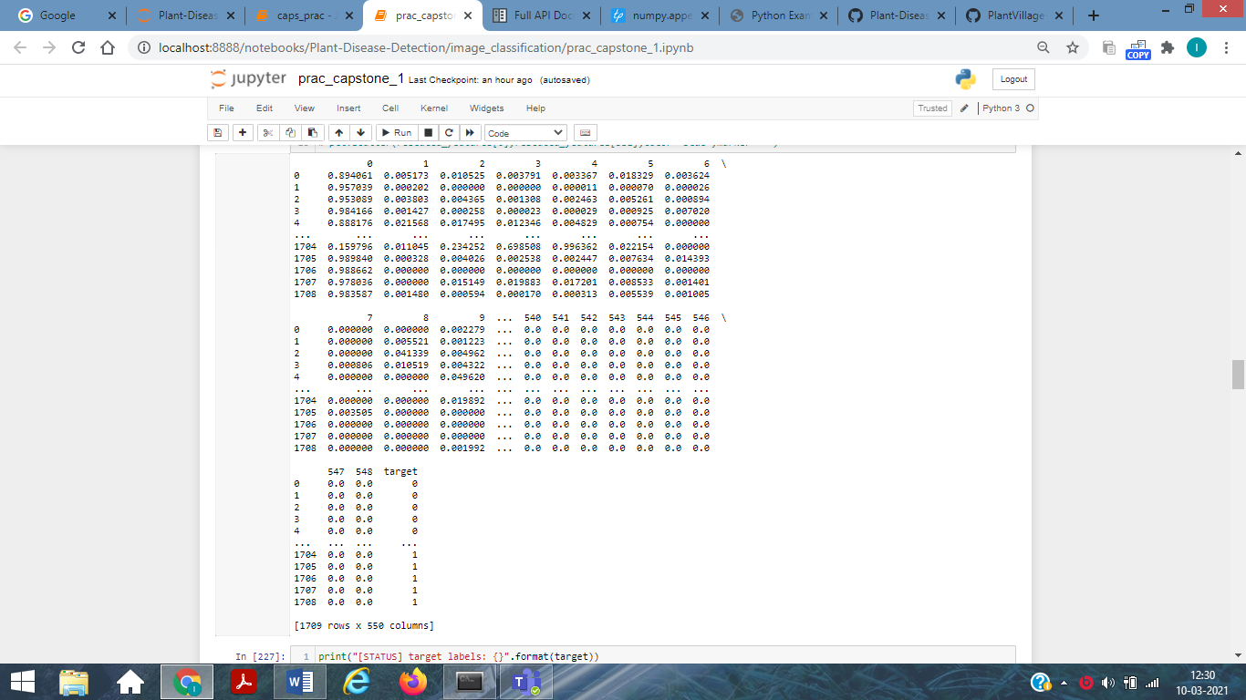

Slide 27
Image Classification
Categorising a plant as either diseased or Healthy is a type of 2 class classification problem.
In this project we have used 3 supervised machine learning algortihm.
1) Gaussian Naïve Bayes
2) Support vector Machine
3) Random Forest

Slide 28
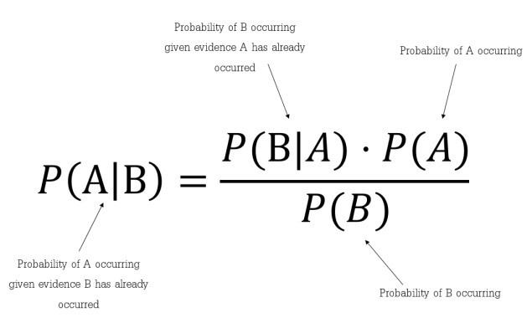
Classifier 1-Gaussian Naïve Bayes
Naïve Bayes is a probabilistic machine learning algorithm based on the Bayes Theorem, used in a wide variety of classification tasks.
Bayes’ Theorem is a simple mathematical formula used for calculating conditional probabilities.
Conditional probability is a measure of the probability of an event occurring given that another event has (by assumption, presumption, assertion, or evidence) occurred.
There is some assumptions made by this algorithm which impacts on the accuracy of this algorithm.
Assumptions: 1) It assumes all features are independent
2) It gives equal importance to all the features i.e. it assumes that all the features have equal weight in classification.

Slide 29
Algorithm
STEP 1: From Training set find the prior probability P(diseased)=(diseased)/(diseased + healthy) P (healthy)=(healthy)/(diseased + healthy).
STEP 2: Find the mean, variance for the all the 550 feature given the target is plant is healthy or diseased separately from the test data, i.e. if plant is healthy calculate the mean and variance of the given feature.
STEP 3: From the test data, for all the leaves we now predict whether that belongs to which class i.e healthy or diseased.

Slide 30
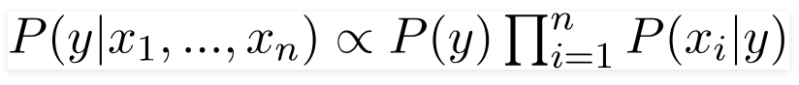
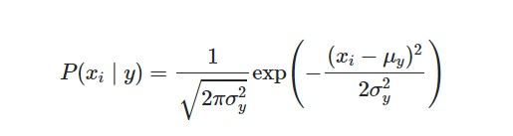

Using below mentioned formulas:
We can see that the denominator is constant for all thus we can create a proportionality:
We can calculate P(Xi/Y) as
Where:
P(y)=prior probability
μ$y$=mean of feature x given class Y or in this case diseased plant or healthy one (from training data)
X_{i=} i^{th} feature value for the test data
σ_{y}² =variance of feature x given class Y or in this case diseased plant or healthy one (from training data)

Slide 31
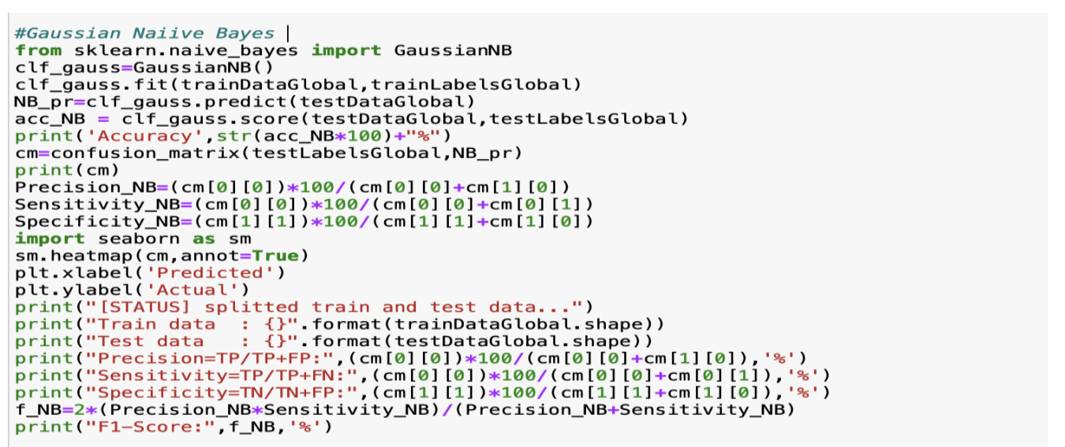
Classifiers Implementation And Results

Slide 32
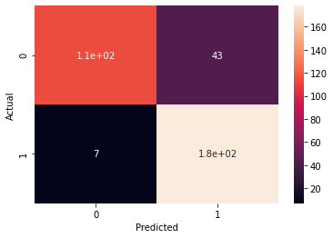
Output Using SLIC Segmentation Technique
Accuracy 85.38011695906432%
[[114 43] [ 7 178]]
[STATUS] splitted train and test data... Train data : (1367, 549) Test data : (342, 549)
Precision=TP/TP+FP: 94.21487603305785 %
Sensitivity=TP/TP+FN: 72.61146496815287 %
Specificity=TN/TN+FP: 96.21621621621621 %
F1-Score: 82.01438848920864 %

Slide 33
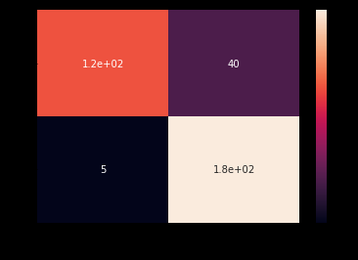
Output Using Masking Segmentation Technique
Accuracy 86.8421052631579%
[[117 40] [ 5 180]]
[STATUS] splited train and test data... Train data : (1367, 549) Test data : (342, 549)
Precision=TP/TP+FP: 95.90163934426229 %
Sensitivity=TP/TP+FN: 74.52229299363057 %
Specificity=TN/TN+FP: 97.29729729729729 %
F1-Score: 83.87096774193547 %

Slide 34
Inference
As stated earlier there are assumption used in this algorithm which is reflected in its accuracy.
Through confusion matrix we can see that out of 529 test data 45 we wrongly classified which is a lot.
We can also see that the accuracy using masking is higher than the SLIC technique.
We can also conclude that the performance of this algorithm is the worst when we compare it with random forest and SVM.

Slide 35
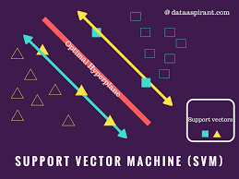
Classifier 2-Support vector Machine
This is a supervised machine learning algorithm which can be used for both classification and regression type of problems.
We are implementing this algorithm as two class classification algorithm but by applying some tweaks we can use it for multiclass classification.
It works well with larger amount of features and data as well.

Slide 36
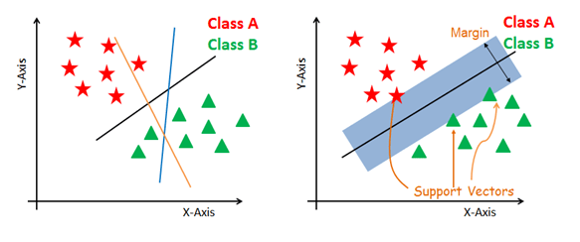
Suppose we have 2 features and want to classify in 2 broad categories shown in the figures.
The objective to SVM is to plot a hyperplane that divides the labelled data into 2 half's.
We also need to plot 2 planes parallel to hyperplane which passes through the nearest point to the hyperplane for both the categories. These points are called support vectors.
We can have multiple such hyperplanes but there is one more constraint i.e we need to maximize the margin distance.
Margin distance is calculated as distance between 2 margin lines.
Maths of SVM

Slide 37
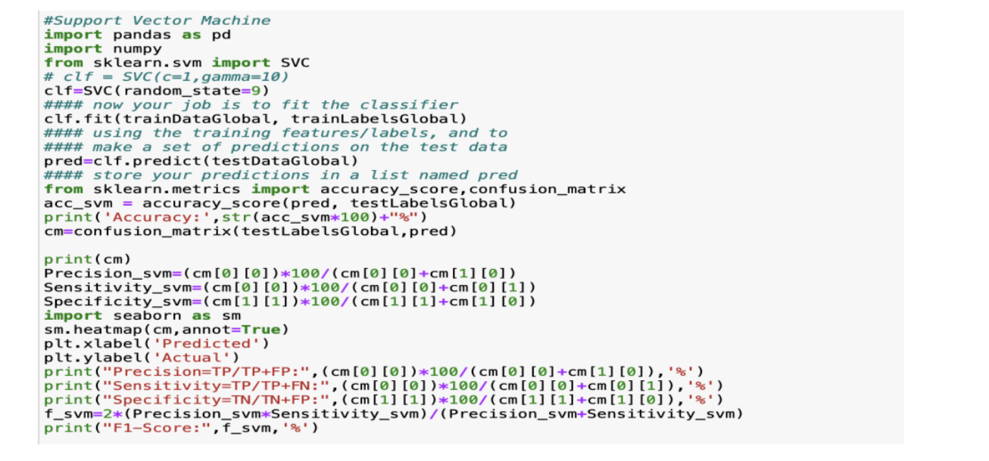
Classifier implementation and Result

Slide 38
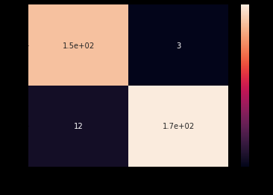
Output Using SLIC Segmentation Technique
Accuracy: 95.6140350877193%
[[154 3] [ 12 173]]
Precision=TP/TP+FP: 92.7710843373494 %
Sensitivity=TP/TP+FN: 98.08917197452229 %
Specificity=TN/TN+FP: 93.51351351351352 %
F1-Score: 95.35603715170278 %

Slide 39
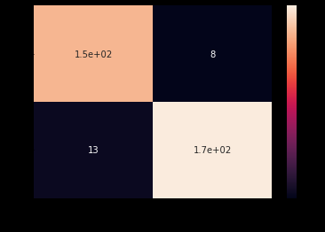
Output Using Masking Segmentation Technique
Accuracy: 93.85964912280701%
[[149 8] [ 13 172]]
Precision=TP/TP+FP: 91.9753086419753 %
Sensitivity=TP/TP+FN: 94.90445859872611 %
Specificity=TN/TN+FP: 92.97297297297297 %
F1-Score: 93.41692789968651 %

Slide 40
Inference
Accuracy of SVM and Random forest algorithm is comparable and very high this is because these algorithms don’t assume anything about features and weight of each features.
The accuracy using SLIC technique is higher than using masking technique.
Through confusion matrix we can see that out of 529 test data 21 we wrongly classified. This is less when we compare this to naïve bayes.

Slide 41
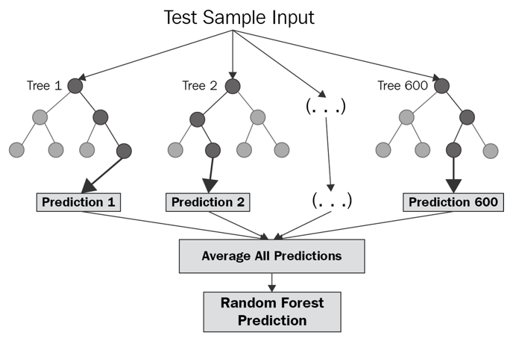
Classifier 3-Random Forest
This is a classification algorithm.
The subroutine of this algorithm is decision tree.
In this algorithm the split the data set and make different decision trees and then take an average and return the result.
Bagging method is used in Random Forest i.e. we fit multiple model in one algorithm.
While building subsets of data for trees, the word “random” comes into the picture. A subset of data is made by randomly selecting x number of features (columns) and y number of examples (rows) from the original dataset of n features and m examples.

Slide 42
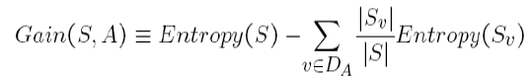
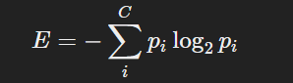
We split the data on the basis of:
Information Gain The information gain is the amount by which the Entropy of the system reduces due to the split that we have done. We have created the tree using observations. We split the with respect to feature X when Gain(S,A) is maximum among the remaining features.
Entropy is a measure of the randomness of a system. The entropy of sample space S is the expected number of bits needed to encode the class of a randomly drawn member of S. Lets suppose we have 14 rows in our data so 14 members.
The entropy of the system is calculated by the above formula where p(x) is the probability of getting class x from those 14 members(assuming). We have two classes here one is Yes and the Other is No in target column.
E(S)= -[p(Yes)*log(p(Yes))+ p(No)*log(p(No))];
Here yes means diseased otherwise healthy

Slide 43
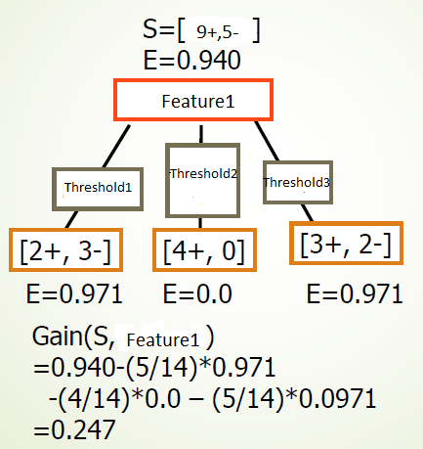

Slide 44

Conclusive Steps for Random Forest using previously mentioned formulas and concepts.

Slide 45
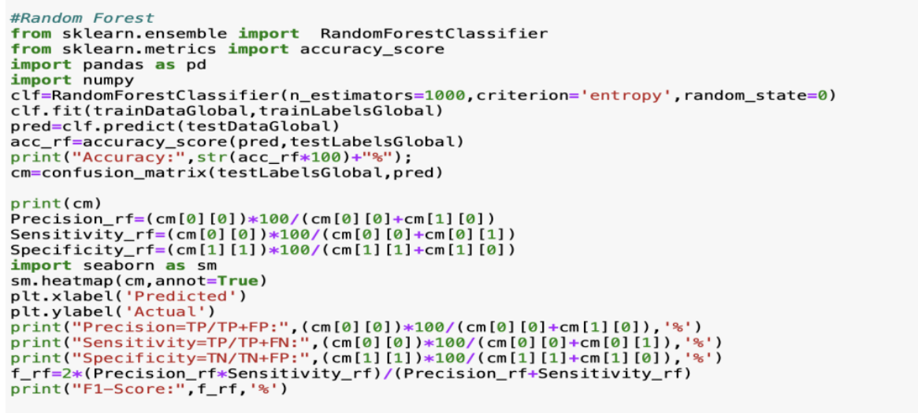
Classifier implementation and results

Slide 46
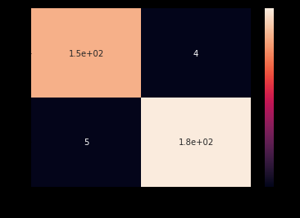
Output Using SLIC Segmentation Technique
Accuracy: 97.36842105263158%
[[153 4] [ 5 180]]
Precision=TP/TP+FP: 96.83544303797468 %
Sensitivity=TP/TP+FN: 97.45222929936305 %
Specificity=TN/TN+FP: 97.29729729729729 %
F1-Score: 97.14285714285715 %

Slide 47
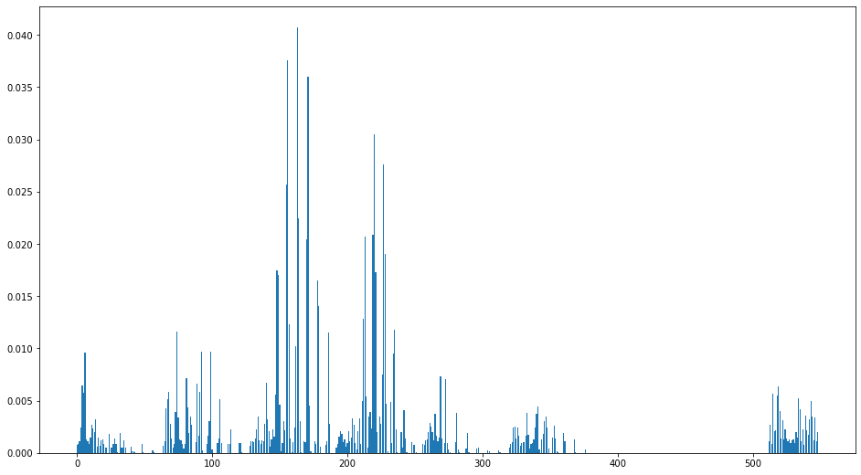
Contribution of Each feature in Classification

Slide 48
Output Using Masking Segmentation Technique
Accuracy: 97.36842105263158%
[[153 4] [ 5 180]]
Precision=TP/TP+FP: 96.83544303797468 %
Sensitivity=TP/TP+FN: 97.45222929936305%
Specificity=TN/TN+FP: 97.29729729729729 %
F1-Score: 97.14285714285715 %

Slide 49
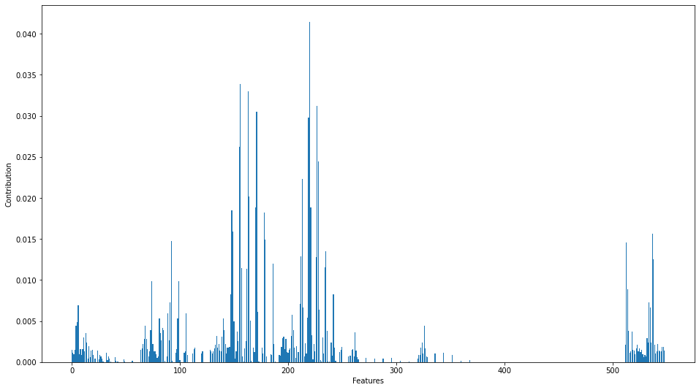
Contribution of Each feature in Classification

Slide 50
Inference
The training time of Random Forest was the highest as it checks for all possible splits at all the node.
Accuracy of Random Forest is around 98% using both the segmentation technique.
The confusion matrix suggest that 9 out of 529 test image were wrongly classified which is lowest compared to other two classifier.

Slide 51
Performance Analysis and Comparison of Algorithms.
We have shown graphical comparison between different classifier.
1) Bar Graph Comparison using SLIC segmentation
2) Tabular Comparison using SLIC segmentation
3) Bar Graph Comparison using Green Masking Technique
4) Tabular Comparison using Green Masking Technique

Slide 52
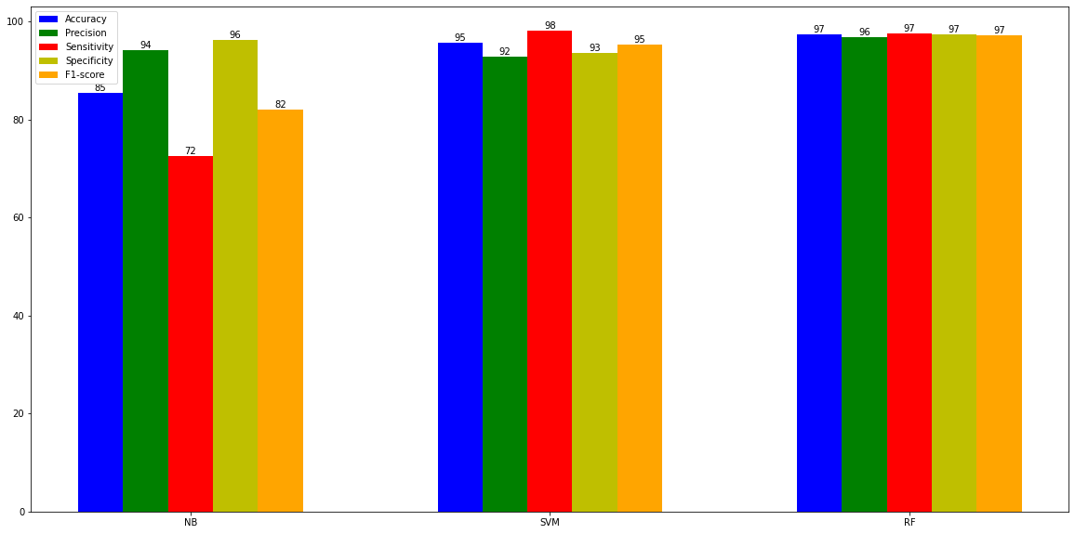
Bar Graph Comparison using SLIC segmentation

Slide 53
Comparison table
Algo used | Accuracy(%) | Precision(%) | Sensitivity(%) | Specificity(%) | F1_score(%)
Gaussian Naive Bayes | 85.380117 | 94.214876 | 72.611465 | 96.216216 | 82.014388
Support Vector Machine | 95.614035 | 92.771084 | 98.089172 | 93.513514 | 95.356037
Random Forest | 97.368421 | 96.835443 | 97.452229 | 97.297297 | 97.142857

Slide 54
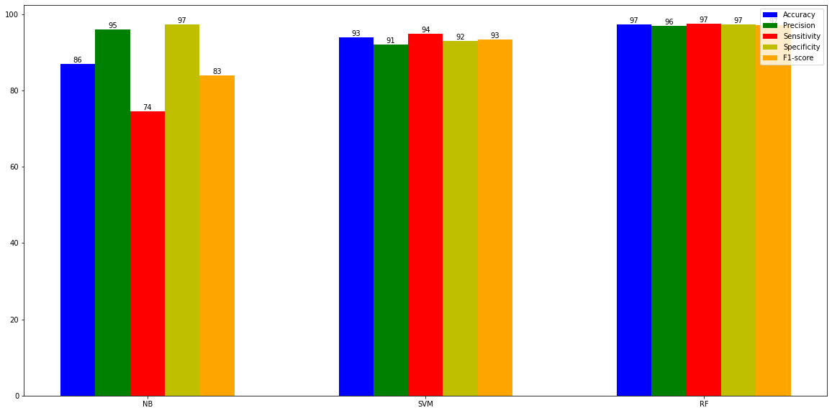
Bar Graph Comparison using Masking segmentation

Slide 55
Comparison table
Algo used | Accuracy(%) | Precision(%) | Sensitivity(%) | Specificity(%) | F1_score(%)
Gaussian Naive Bayes | 86.842105 | 95.901639 | 74.522293 | 97.297297 | 83.870968
Support Vector Machine | 93.859649 | 91.975309 | 94.904459 | 92.972973 | 93.416928
Random Forest | 97.368421 | 96.835443 | 97.452229 | 97.297297 | 97.142857

Slide 56
Conclusions from comparison tables and graphs
1)Gaussian Naïve Bayes performs the worst among the three:
As It is a Parametric model ,where generally we have a mathematical equation involved which works under specific circumstances in order to function properly. In other words, there is set of strict assumptions that should be fulfilled which allow the algorithm that the data belongs to particular family of distributions.
Therefore its accuracy is less compared to others as its not flexible and assumes parameters are independent which might not be the case.
Another way to say this is that it usually isn’t the case that P(Z| X, Y) = P(Z|X) * P(Z|Y), which naive Bayes classification assumes.

Slide 57
2) SVM works better than Naïve Bayes
As it chooses the most optimal model of all the models its generate i.e. hyperplane with the maximum margin.
Kernel can be used to increase the dimensionality of the feature set, therefore making separation of data into classes easier than in the lower dimensionality.
But works less efficiently than random forest.
3)Random forest works best
as at each level of splitting the node it consider the best feature to separate into classes in the form of maximum information gain.
Since it’s a rule based algorithm ,so decision making is better than other algorithms.

Slide 58
References
Ko Ko Zaw, Zin Ma Ma Myo, and Wah Wah Hlaing. 2018. “Multiclass Support Vector Machine Based Detection and Classification of Leaf Diseases”, 11th National Conference on Science and Engineering, YTU, Yangon,
S. S. Panchal, R. Sonar. 2016. “Pomegranate Leaf Disease Detection Using Support Vector Machine,” International Journal of Engineering and Computer Science, vol. 5, no 6, pp. 16815-16818.
D. Gadkari. 2004. “Image Quality Analysis Using GLCM,” M.E. thesis, University of Central Florida, Orlando, Florida.
Cong, Jinyu & Wei, Benzheng & Yin, Yilong & Xi, Xiaoming & Zheng, Yuanjie. (2014). Performance evaluation of simple linear iterative clustering algorithm on medical image processing. Bio-medical materials and engineering. 24. 3231-8. 10.3233/BME-141145.

Slide 59
Prakash M. Mainkar, Shreekant Ghorpade and Mayur Adawadkar “Plant Leaf Disease Detection and Classification Using Image Processing Techniques” International Journal of Innovative and Emerging Research in Engineering Volume 2, Issue 4, 2015, e-ISSN: 2394 – 3343, p-ISSN: 2394 – 5494.
Sabah Bashir and Navdeep Sharma “Remote Area Plant Disease Detection Using Image Processing” IOSR Journal of Electronics and Communication Engineering (IOSRJECE) ISSN : 2278-2834 Volume 2, Issue 6 (Sep-Oct 2012), PP 31-34.
Dheeb Al Bashish, Malik Braik and Sulieman Bani-Ahmad “A Framework for Detection and Classification of Plant Leaf and Stem Diseases” 2010 IEEE International Conference on Signal and Image Processing, pp. 978-1-4244-8594-9/10.
Zulkifli Bin Husin, Abdul Hallis Bin Abdul Aziz, Ali Yeon Bin Md Shakaff and Rohani Binti S Mohamed Farook “Feasibility Study on Plant Chili Disease Detection Using Image Processing Techniques” 2012 IEEE Third International Conference on Intelligent Systems Modelling and Simulation, pp. 978-0-7695-4668-1/12.
Sachin D. Khirade, A. B. Patil, “Plant Disease Detection Using Image Processing” 2015 IEEE International Conference on Computing Communication Control and Automation, pp. 978-1-4799-6892-3/15.

Slide 60


